Slide 1

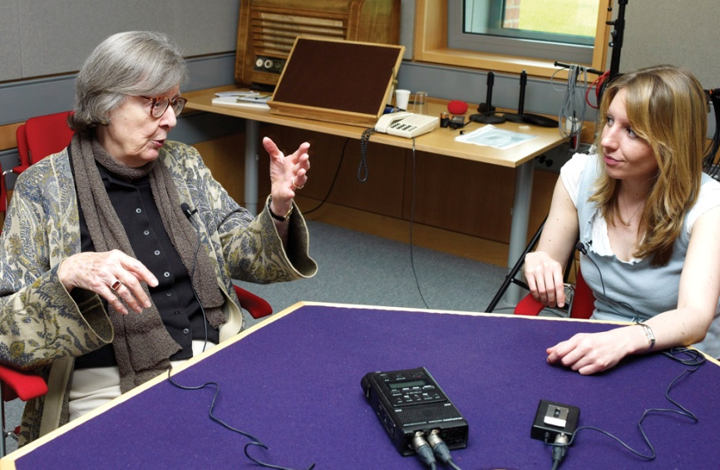
Collecting through National Life Stories fieldwork projects
National Life Stories is an oral history fieldwork charity based in the British Library with its own Board of trustees and project advisors. It has been collecting oral histories for 25 years.
For information on all the NLS projects see www.bl.uk/nls
And http://en.wikipedia.org/wiki/National_Life_Stories for additional history of NLS

Slide 2
The Nature of NLS Interviews
NLS interviews take the life story approach and consist of extended exchanges between interviewer and interviewee, with the longest now in excess of 100 hours. The interviews cover all aspects of an individual’s life and work from their earliest memories to the time of the interview. They are conducted by specialist interviewers with the intention to provide a lasting national resource that will be made widely available to researchers of all types. The life story approach is not aimed at gathering material for a specific research project, rather it seeks to capture a record of a life ‘in the round’, covering the working life but not concentrating exclusively on it. Given the ephemeral nature of modern communications such interviews may well come to constitute the major archival records of key figures of our time.

Slide 3
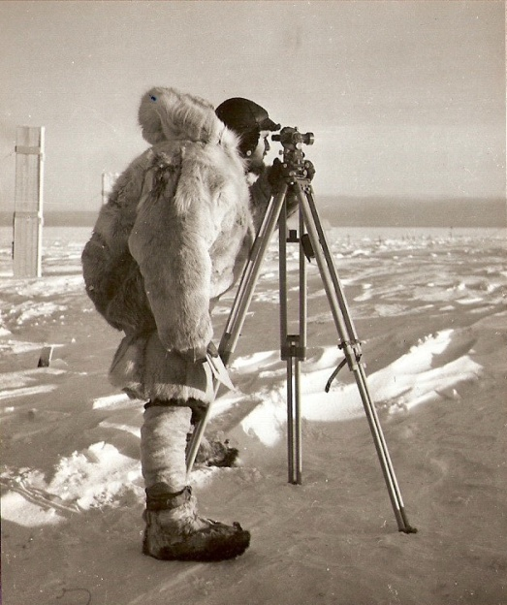
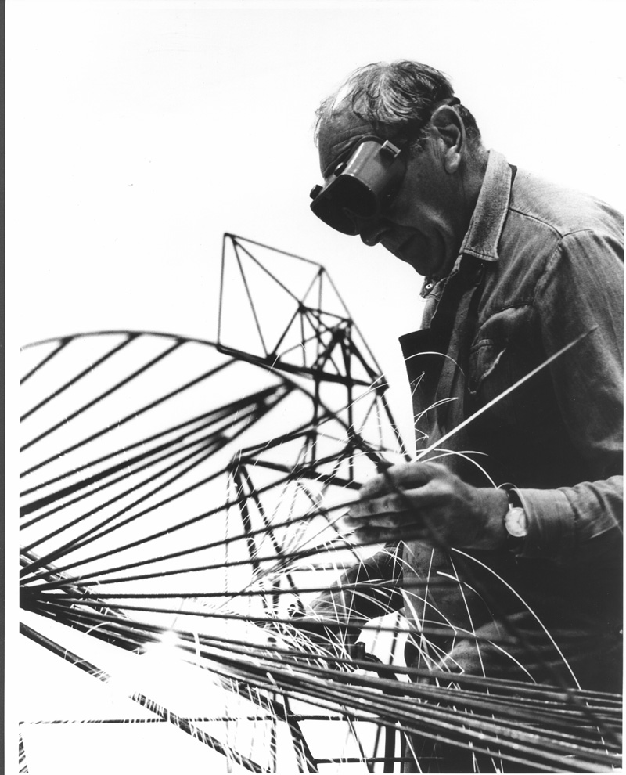
Collecting through National Life Stories fieldwork projects
  Active projects include:
  Architects' Lives (C467)
  Artists' Lives (C466)
  Authors' Lives (C1276)
  Crafts Lives (C960)
  Pioneers in Charity and Social Welfare (C1155)
  An Oral History of British Science (C1379)
  An Oral History of the Electricity Supply Industry (C1495)
  Find further information at www.bl.uk/nls and via the online NLS annual reports
Top: Picture courtesy of Science interviewee Charles Swithinbank
Bottom: Artist Lynn Chadwick at work in his studio. Photo used by kind permission of the Chadwick family

Slide 4
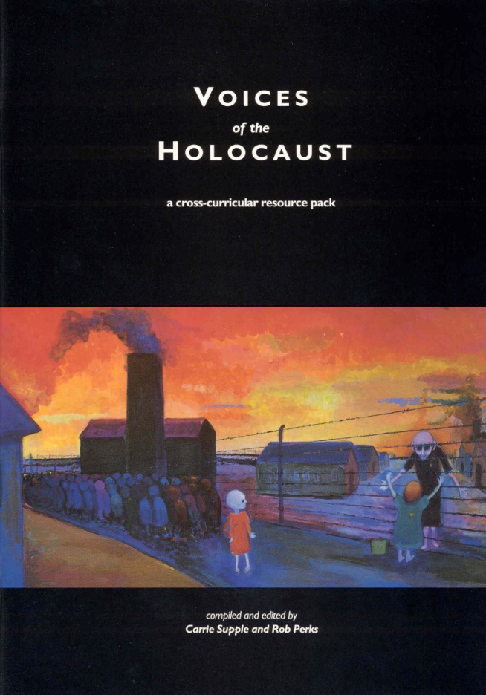
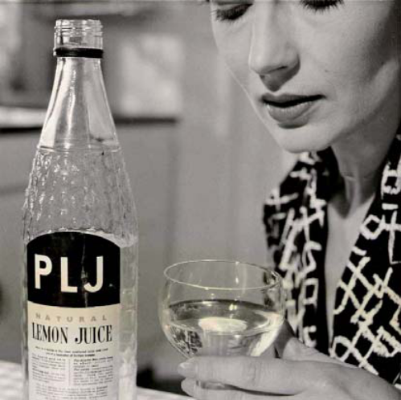
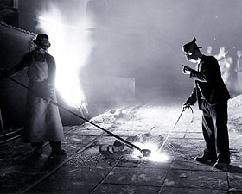
Collecting: fieldwork projects (National Life Stories)
NLS Projects completed
  Book Trade Lives (C872)
  City Lives (C409)
  Fawcett Collection (C468)
  Food: From Source to Salespoint (C821)
  Lives in Steel (C532)
  Lives in the Oil Industry (C963)
  Living Memory of the Jewish Community (C410)

Slide 5
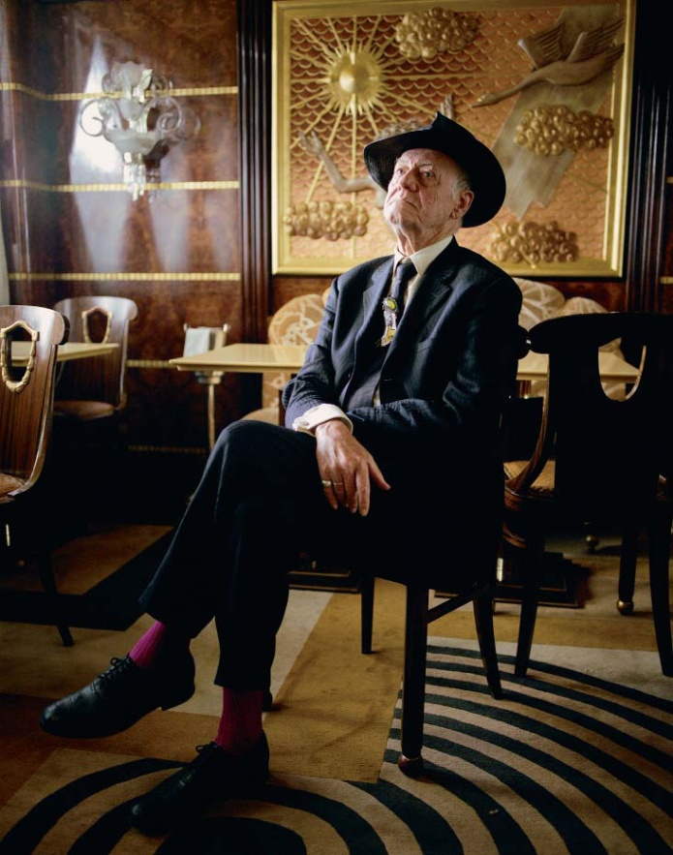
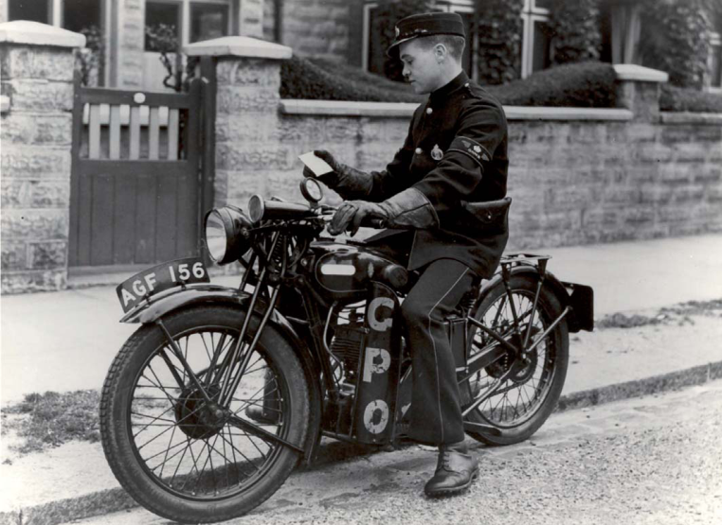
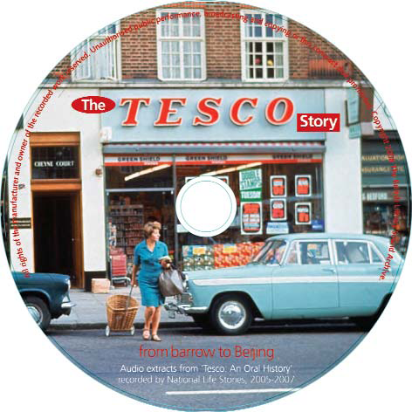
Collecting: fieldwork projects (National Life Stories)
NLS Projects completed (cont)
  An Oral History of British Fashion (C1046)
  An Oral History of British Press (C638)
  An Oral History of the Post Office (C1007)
  An Oral History of British Theatre Design (C1173)
  An Oral History of the Wine Trade (C1088)
  An Oral History of Wolff Olins (C1015)
  Tesco: An Oral History (C1087)
Interviewee Percy Savage

Slide 6
Access to the British Library’s oral history collections
    Accessing NLS and other British Library Oral History Material
    Search the catalogue (http://cadensa.bl.uk)
    All recordings are accessible onsite via the Listening & Viewing Service (www.bl.uk/listening)
    For non-digital material you will need to make an appointment
    Pick the recordings you wish to listen to
    Email or phone the L&V Service to make an appointment: listening@bl.uk or 020 7412 7418.
    For digital material (either born-digital or digitised) you can use the SoundServer service available in BL reading rooms in St Pancras and Boston Spa.
6

Slide 7
Access, use and re-use: changing times
Offsite Access to Oral History Material
Internet access to a wide selection of recordings via British Library Sounds http://sounds.bl.uk
Access to audio clips through curated platforms such as the BL Learning websites, eg Playtimes and Food Stories
Access to Unheard Voices
Online access via Disability Voices’ content package on BL Sounds –
http://sounds.bl.uk/oral-history/disability-voices
Notes:
15:30
Ellie
7

Slide 8
Using NLS Material
Although NLS has primarily concerned itself with collecting oral histories, is it also active in promoting the use of its collections in a range of contexts, for example
Researchers of all types
Production of CDs for use in education and training
Websites for a range of audiences
In exhibitions alongside the objects being discussed, eg Jacqueline Stieger exhibition in 2011
By biographers and obituary writers

Slide 9
Oral History of British Science
Project started in November 2009
Aims to collect 200 interviews with leading British scientists and their less well-known co-workers. A response to the recognition that very little oral history has been undertaken in this area
Four strands: Factory of Life, Cosmologies, Changing Planet, Made in Britain
Funding from Arcadia for two of these, Changing Planet and Made in Britain
Focus on audio with selected interviewees also participating in video interviews with key objects or in key locations

Slide 10
Oral History of British Science
Two freelance interviewers arrange and carry out the interviews
Interviewees are selected through discussion with the Advisory Committee after detailed consideration of each area
Interviews are generally carried out in interviewee’s home or office, or at the BL over a number of sessions
Recorded as WAV files and downloaded. Detailed summaries are produced which are searchable through Cadensa. Interviews are transcribed in full
Where copyright permission allows, made available via BL Sounds

Slide 11
Oral History of British Science: Progress so Far
Over 70 interviews completed or in progress
41 interviews available via BL Sounds, including a few from earlier NLS projects
8 video interviews, 6 available via British Library You Tube Channel
Presentations to a range of academic and other conferences
Blog showcasing some of the material collected

Slide 12
Oral History of British Science: Future Developments
Major web resource under development which will make the material more accessible to a wide range of audiences
Publication of scholarly articles using the material
Promoting use of interviews by researchers of all types
Seeking further funding for other strands and more interviews within existing strands

